Slide 1
Welcome to
First Grade!
2021-2022

Slide 2
On the Ride to Success at KLES!
Mrs. Thorp
First Grade
Rm. 514

Slide 3
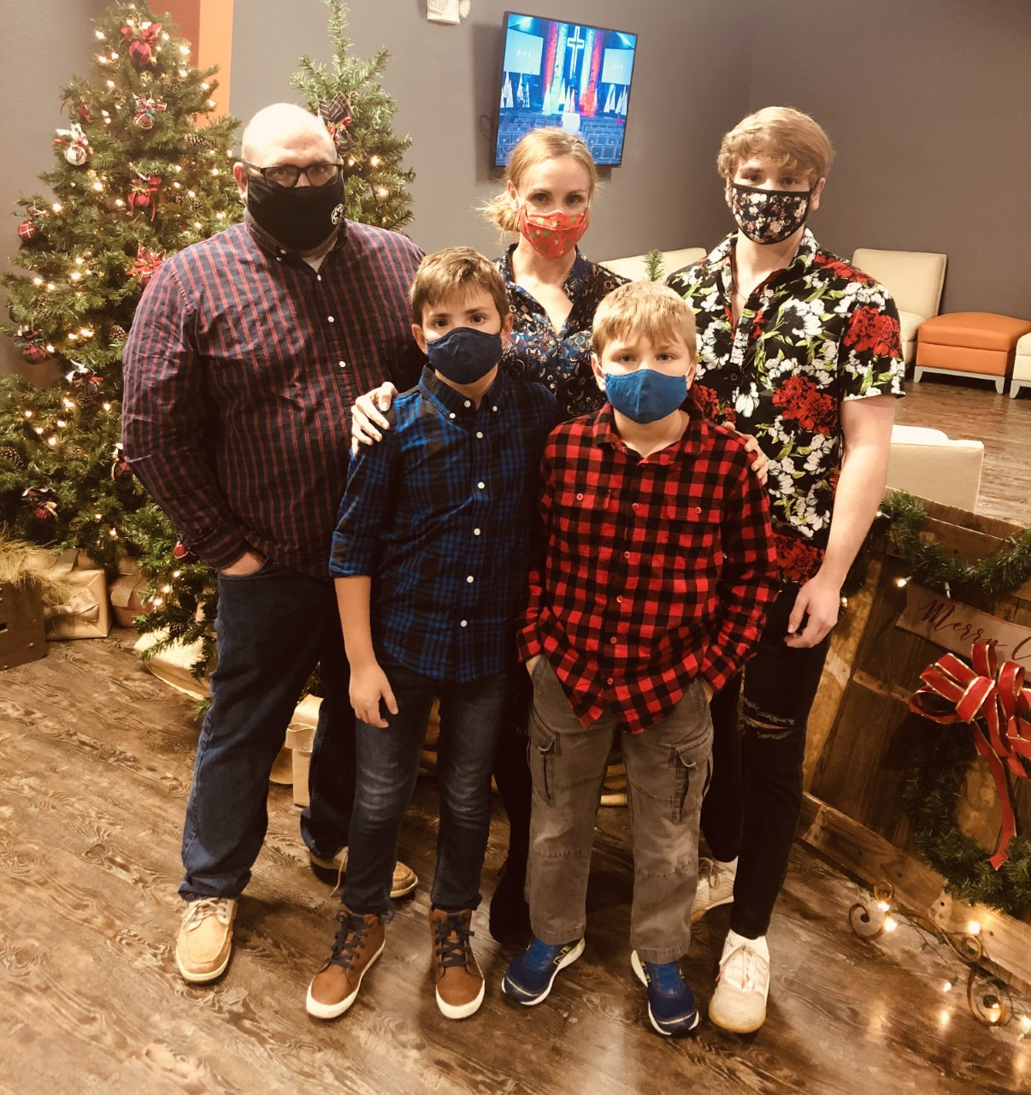
Meet Mrs. Eichenlaub
Meet Mrs. Thorp
My name is Ellen Thorp. I am very excited to begin my fifth year as a KLES Leprechaun and 19th overall with Leon County. I am from Florida and moved to Tallahassee, FL in 1998 to attend FSU for Elementary Education. I am married to my snazzy husband, Mark, whom I met in college and we have three amazing children: Joshua, who attends FSU, Nathan, who is in Middle School, and Jacob, who is a here at KLES ☺ They are so much fun and always have me running them to a sport!
I am very excited about this school year. It's going to be a year of fun, learning, and lots of adventures. I can't wait to see what the year has in store for us!

Slide 4
Education & Experience
My love for teaching began in Regular Education in 2003 (really way before, but that’s what my degree says) where I discovered my love for the Inclusion model with ESE students. I’ve spent most of my time in PreK-First grade with a year I’ll never forget teaching Middle School!!!
B.S. in Elementary Education 2003
Early Childhood 2009
Exceptional Education 2012
Reading endorsement
ESOL endorsement
Ongoing Professional Courses

Slide 5
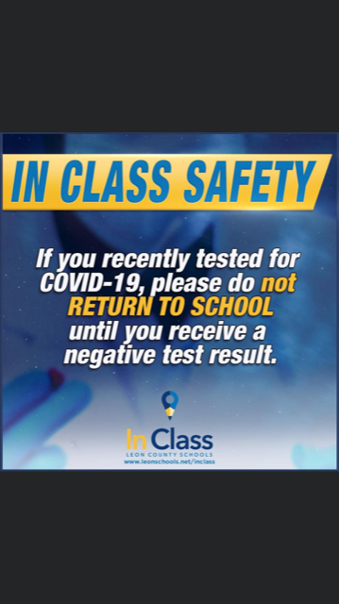
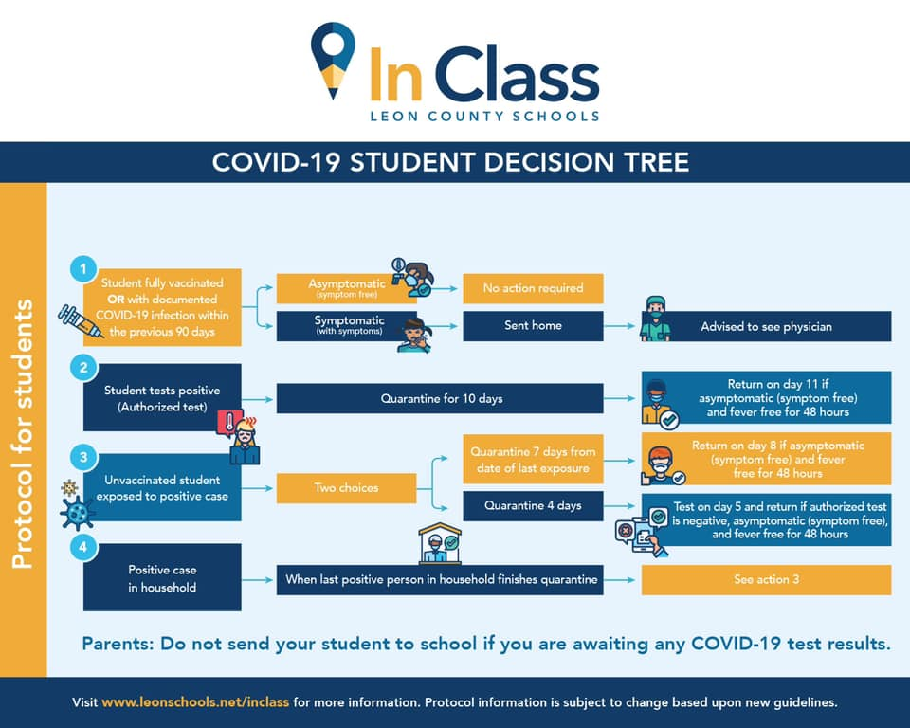
Health & Safety

Slide 6
Health & Safety
Frequent hand washing and classroom sanitation done regularly throughout the day.
Masks are required when indoors, per our county.
Students will receive mask breaks as determined by the teacher’s schedule.
If your child exhibits any sign of illness, please keep your child home to rest and get better. Any student with a fever of a 100.0 is required to stay home until fever free for 48 hours without the aide of a fever reducing medication (Tylenol, Motrin, etc.)

Slide 7
Our First Grade Day at KLES
Morning Meeting/Calendar/Social Emotional Learning ELA/SS Whole Group Snack/Bathroom Break Workshop Centers Special Area Lunch Math
Recess
Science/SS Whole Group Wrap Up/Dismissal

Slide 8
ELA Curriculum
Taking pride and time to
complete work to the best of their ability.
195 First Grade Sight Words
Working through our new BEST standards
Monthly STAR Early Literacy Tests
i-Ready Reading
Key Details and other
Comprehension Strategies

Slide 9
Math Curriculum
Model, Read, and Write 0-120
• Represent, Compare, and Order Sets to 20
• Adding/Subtracting in a variety of ways
• 2D/3D shape manipulation
• Data and Graphing

Slide 10
Classroom & School-Wide Rules
Each child has individual behavior needs ☺
We are always encouraging independence and first time listening. Thank you for
your support at home!
Leprechaun Leaders-School wide Positive Behavior System
Be Respectful
Be Responsible
Be Ready to Learn

Slide 11
Meet Mrs. Eichenlaub
Friday Resource Room Folder
Home/School Communication Tool
Please read and clean out Friday Folder weekly.
Comes back and forth from home to school Friday/Monday.
Finished Schoolwork
Important Notes
Transportation Changes

Slide 12
Lunch/Snack Procedures
We will have a mid-morning snack time before SA. Every once in awhile I may ask you to replenish our Snack bin ☺ We will have our snack outdoors when weather permits.
Students will have a 25-minute lunch. FREE hot lunches will be served, or you may bring a lunch from home.

Slide 13
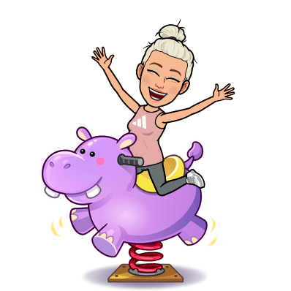
Special Area
We have Special Area (SA) everyday!
Media, PE (2 rotations), Art, Guidance, and Music
We have a 6-day rotation schedule. On our Media day we will checkout and return books.

Slide 14
Contact Information
Email- thorpe@leonschools.net
Phone number- 850-921-1265
Please send any important notes in your
child’s Friday folder.
Ways to Stay Connected
KLES Listserv
Facebook “Principal Brenda Wagner”
Instagram #Killearnlakeselementary
PTO Facebook-page Killearn Lakes Elementary School PTO

Slide 15
Questions?
Thank you so much for stopping by, and please do not hesitate to reach out if you have any questions or concerns!
I can’t wait to “RIDE” into First Grade with you!

